Slide 1
A New Algorithm for Data Compression

Slide 2
Introduction
The paper introduces a new data compression algorithm called Byte Pair Encoding (BPE)
Notable as the large language model tokenizer
Compression algorithms common approach is to replace occurring patterns with shorter representations
BPE provides as much compression as the popular Lempel, Ziv, and Welch (LZW) method
BPE's compression speed is somewhat slower than LZW's, but BPE's expansion is faster making it ideal for applications with limited memory.
Notes:
Faster bcuz the expansion algorithm operates in a single pass, it can get input from a stack or given input

Slide 3
Compression Algorithm
Available Character Set
Character | Code
A | 0
B | 1
C | 2
D | 3
E | 4
F | 5
G | 6
H | 7
How it works?
Find most frequent pairs of characters next to it, replace it with character that is not yet used in the pair table
Pair table contains the available characters
Original input data string: ABABCABCD
Change pair AB to unused H: HHCHCD
Change pair HC to unused G: HGGD

Slide 4
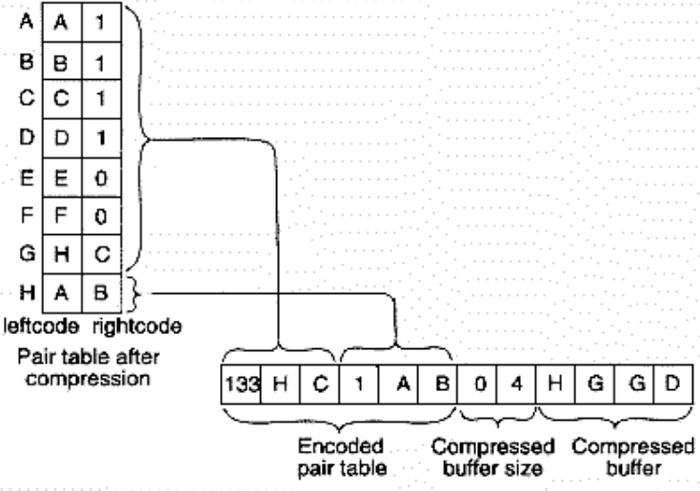
Encoded Pair Table
Motivation(WHY):
Each pair substitution occupies 3 bytes in pair table, if they are directly wrote into data, there will be waste of space.
Method(HOW):
Instead of whole pair table, the encoded pair table can be used to optimize storage, by using negative or non-negative count before pairs.
Example:
Encoded pair table
133 means to skip a range of 6;
1 means to read 1 pair of bytes;
Other bytes in Encoded pair table are pair substitutions.
Buffer size is the length of compressed buffer;
Next is the Compressed content.
DEC | BIN | COUNT
133 | 1000 0101 (N) | 133-127=6
1 | 0000 0001 (P) | 1

Slide 5
Expansion Algorithm
Operates in single pass
Receives a byte either from input file or the stack
Process the byte by following rules:
If the byte is literal: pass it to output
If the byte represents a pair: replace it with the pair and push the pair into the stack
The algorithm keeps obtaining the next byte from the stack as long as the stack is not empty
If the stack is empty, the algorithm obtains the next byte from input file

Slide 6
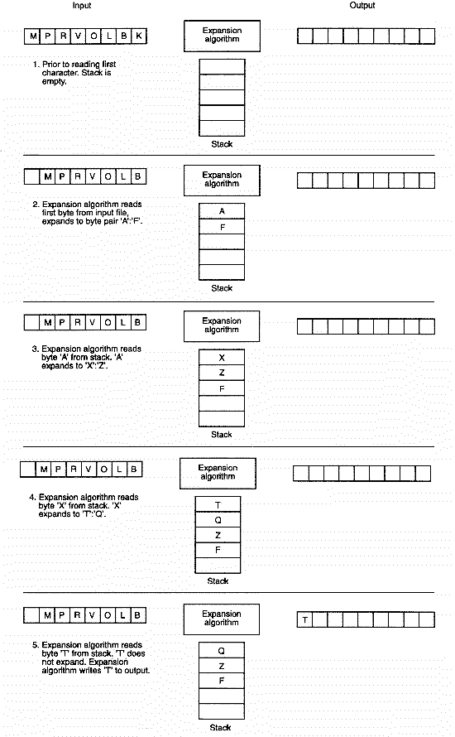
Expansion Algorithm
K
A
X
A | F
X | Z
T | Q
The pair table

Slide 7
Advantages and Disadvantages
Advantages:
a small expansion routine,
low memory usage,
tunable performance, and
good performance on worst-case data (i.e.: binary file)
Faster expansion than most other available compression algorithm
Disadvantages
slow compression speed
lower compression ratio than provided by some of the commonly used algorithms
the algorithm cannot handle streams
Limited memory to compress large file
Notes:
+stream is continuous data, it’s like a live dynamic data. Compression slow cuz it iterates over and over to find the recurring pairs

Slide 8
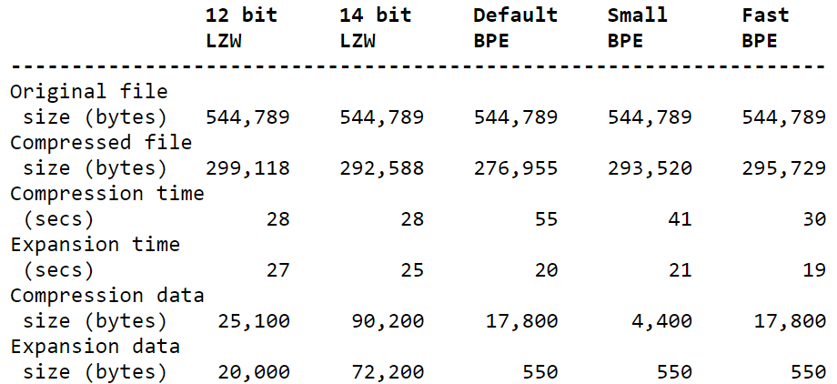
Table 1: BPE’s Performance compared to other algorithm

Slide 9
Thank you for your attention
:)

